Slide 1
Data Structure Trees – Binary Search Trees
By
Dr. Shubhangi Sapkal

Slide 2
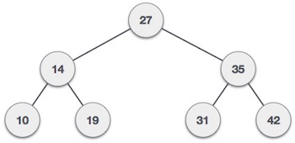
Binary Search Tree
Binary Search tree exhibits a special behavior. A node's left child must have a value less than its parent's value and the node's right child must have a value greater than its parent value.

Slide 3
Tree Node
struct node {
int data;
struct node *leftChild;
struct node *rightChild;
};

Slide 4
BST Basic Operations
The basic operations that can be performed on a binary search tree data structure, are the following −
Insert − Inserts an element in a tree/create a tree.
Search − Searches an element in a tree.
Preorder Traversal − Traverses a tree in a pre-order manner.
Inorder Traversal − Traverses a tree in an in-order manner.
Postorder Traversal − Traverses a tree in a post-order manner.

Slide 5
Insert Operation
The very first insertion creates the tree. Afterwards, whenever an element is to be inserted, first locate its proper location. Start searching from the root node, then if the data is less than the key value, search for the empty location in the left subtree and insert the data. Otherwise, search for the empty location in the right subtree and insert the data.

Slide 6
Insert Operation - Algorithm
If root is NULL
then create root node
return
If root exists then
compare the data with node.data
while until insertion position is located
If data is greater than node.data
goto right subtree
else
goto left subtree
endwhile
insert data
end If

Slide 7
Search Operation
Whenever an element is to be searched, start searching from the root node, then if the data is less than the key value, search for the element in the left subtree. Otherwise, search for the element in the right subtree. Follow the same algorithm for each node.

Slide 8
Search Operation - Algorithm
If root.data is equal to search.data
return root
else while data not found
If data is greater than node.data
goto right subtree
else
goto left subtree
If data found
return node
endwhile
return data not found
end if

Slide 9
Tree Traversal
Traversal is a process to visit all the nodes of a tree and may print their values too. Because, all nodes are connected via edges (links) we always start from the root (head) node. That is, we cannot randomly access a node in a tree. There are three ways which we use to traverse a tree −
In-order Traversal
Pre-order Traversal
Post-order Traversal

Slide 10
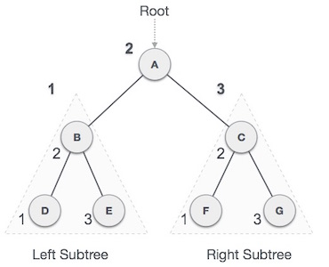
In-order Traversal
In this traversal method, the left subtree is visited first, then the root and later the right sub-tree. We should always remember that every node may represent a subtree itself.
D → B → E → A → F → C → G

Slide 11
In-order Traversal - Algorithm
Until all nodes are traversed −
Step 1 − Recursively traverse left subtree.
Step 2 − Visit root node.
Step 3 − Recursively traverse right subtree.

Slide 12
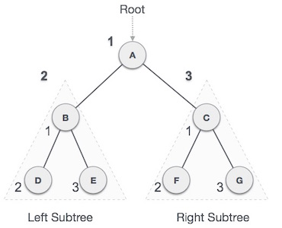
Pre-order Traversal
In this traversal method, the root node is visited first, then the left subtree and finally the right subtree.
A → B → D → E → C → F → G

Slide 13
Pre-order Traversal - Algorithm
Until all nodes are traversed −
Step 1 − Visit root node.
Step 2 − Recursively traverse left subtree.
Step 3 − Recursively traverse right subtree.

Slide 14
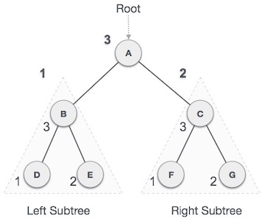
Post-order Traversal
In this traversal method, the root node is visited last, hence the name. First we traverse the left subtree, then the right subtree and finally the root node.
D → E → B → F → G → C → A

Slide 15
Post-order Traversal - Algorithm
Until all nodes are traversed −
Step 1 − Recursively traverse left subtree.
Step 2 − Recursively traverse right subtree.
Step 3 − Visit root node.

